Slide 1
1
3
Scaling on CEM/SCEM
facing SWBC
Scaling on BPM
facing BC
Scaling: Mg(OH)₂
The leakage of OH⁻
Water splitting
Scaling: Ca(OH)₂
The transport of Mg²⁺/Ca²⁺
BPM
BPM
AEM
CEM/SCEM
BPM
BPM
EC
AC
+
SWBC
-
BC
EC
+
+
+
+
-
-
3
-
-
+
-
OH⁻
+
+
+
+
-
-
Cl⁻
Ca²⁺
-
-
1
-
+
+
+
Water splitting
H+
+
…
OH⁻
…
+
+
(Major)
2
-
-
-
Leakage
-
-
H⁺
H⁺
OH⁻
-
OH⁻
OH⁻
+
+
+
(Minor)
+
+
-
-
Ca²⁺
Mg²⁺
Na⁺
-
-
+
Mg²⁺
Ca²⁺
Na⁺
-
+
+
+
+
-
-
-
-
+
+
+
-
+
+
2
Scaling on CEM/SCEM
facing BC
Scaling: Mg(OH)₂, Ca(OH)₂, CaCO₃
The transport of Mg²⁺/Ca²⁺
Notes:
Abstract diagram. Schematic illustration of mechanisms of scaling generation in BMED system (EC: electrode chamber; AC: acid chamber; SWBC: seawater brine chamber; BC: base chamber). (b) The procedure of scaling formation on both sides of CEM/SCEM. (A_{eff} = effective membrane area; I_{lim} = limiting current)

Slide 2
BPM
AEM
CEM
BPM
AEM
CEM
BPM
AEM
CEM
BPM
-
-
-
-
+
+
-
+
+
-
+
+
-
+
-
-
-
-
+
-
-
-
-
+
+
+
+
+
+
+
-
-
-
-
+
+
-
+
+
-
+
+
-
+
-
-
-
-
Electrode Chamber
Seawater Brine Chamber
Acid Chamber
Base Chamber
Acid flow
Base flow
Seawater brine flow
Electrode flow
Notes:
Figure 1. The configuration of lab-scale experimental BMED stack.

Slide 3
a
b
c
d
e
Notes:
Figure 2. (a) Conductivity changes in SWBC; (b) Voltage changes across the BMED system; (c) Variation of stack resistance, chamber resistance and membrane resistance; (d) pH change in SWBC; (e) Concentration of generated acid and base during BMED treating different solutions (SWB, seawater brine; NaCl, the sodium chloride solution with the same conductivity as SWB).

Slide 4
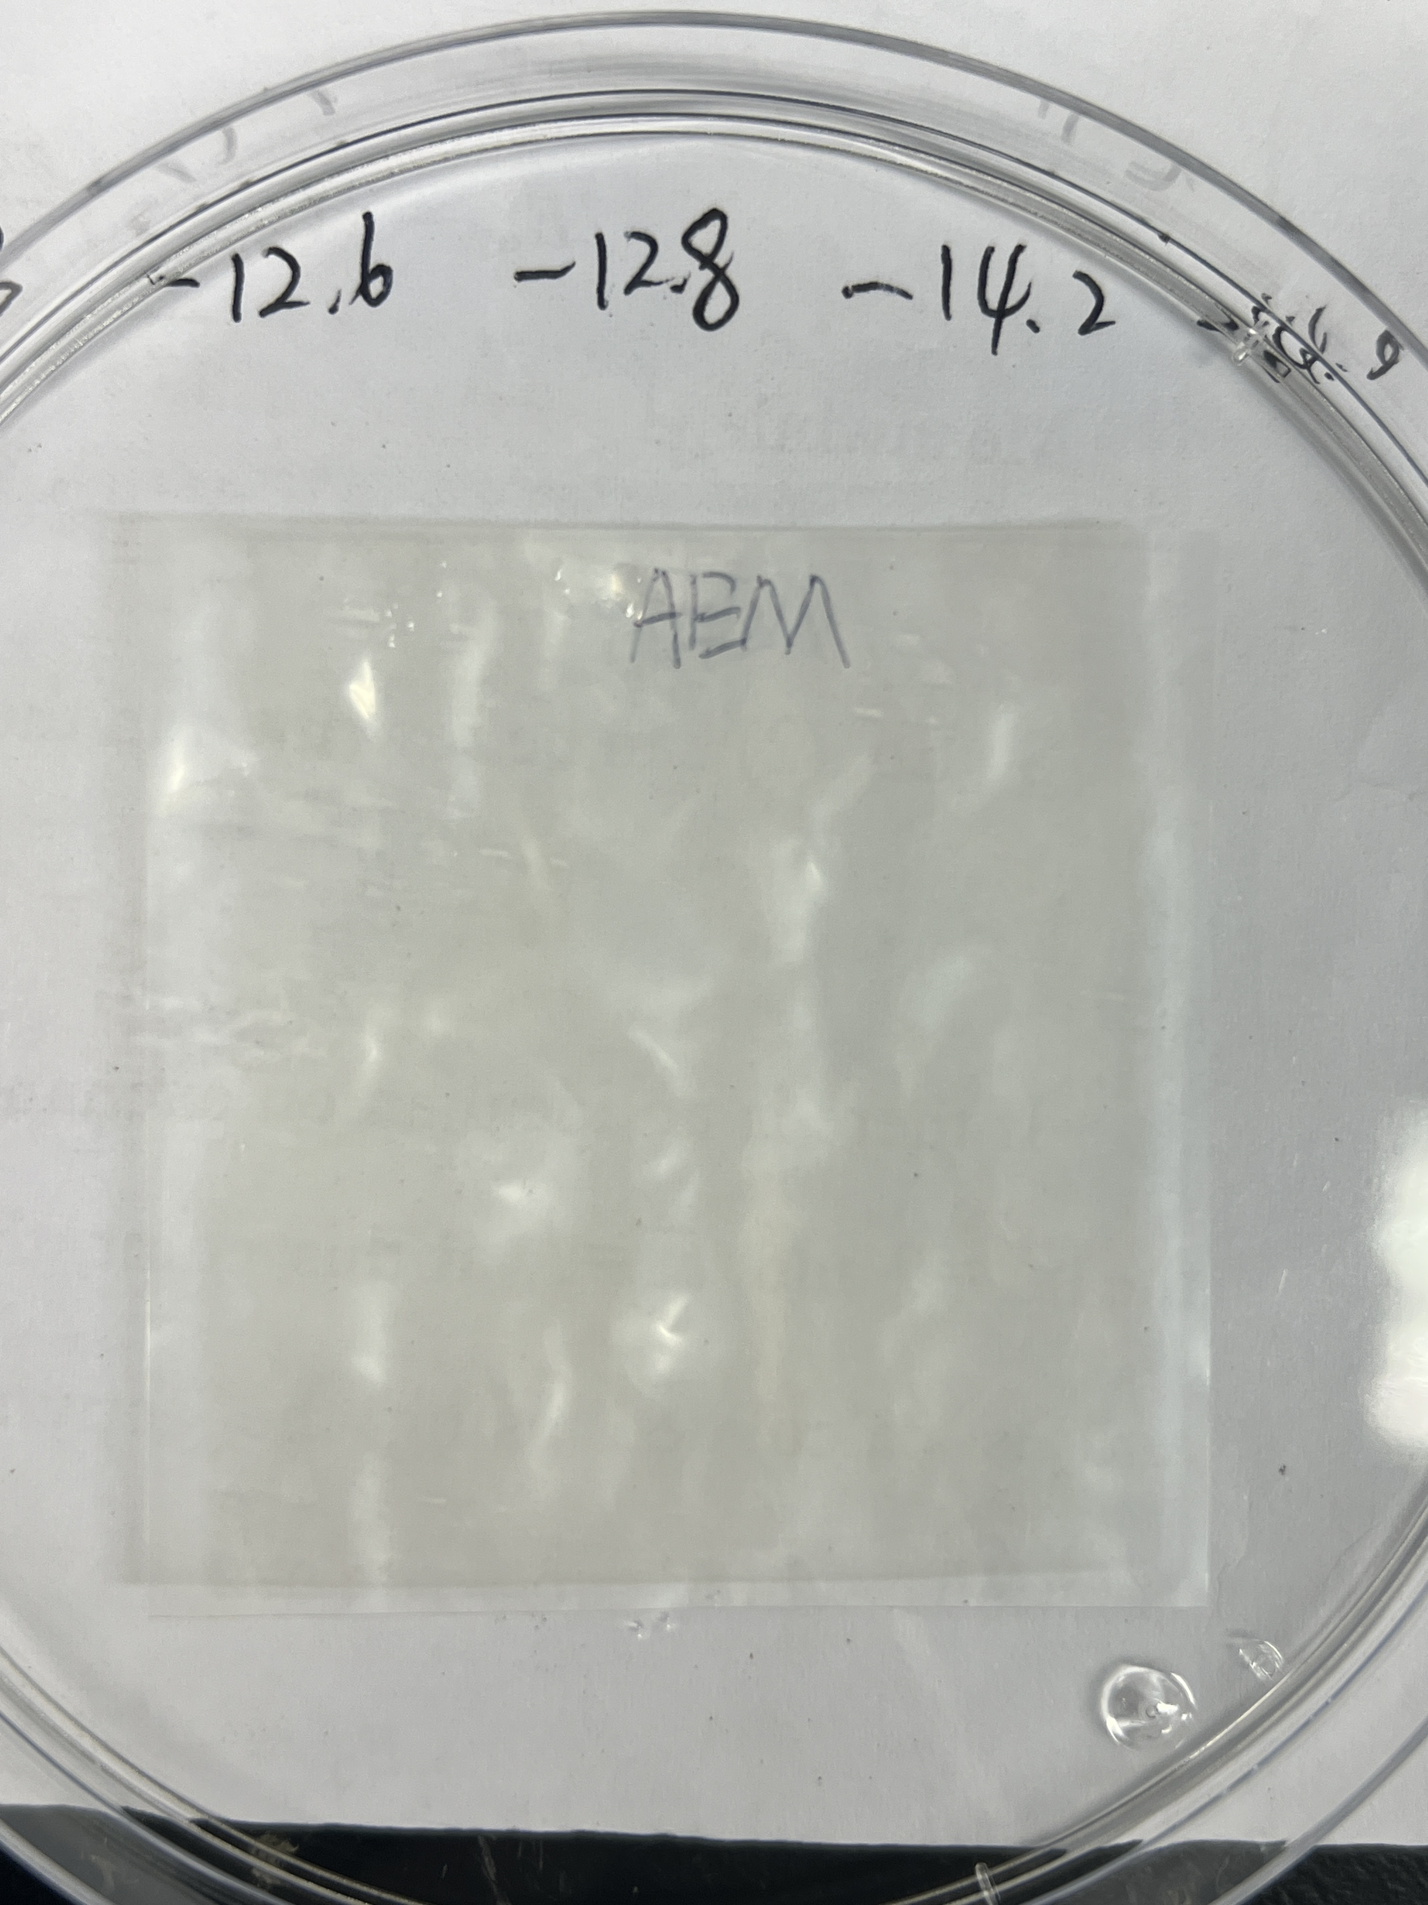
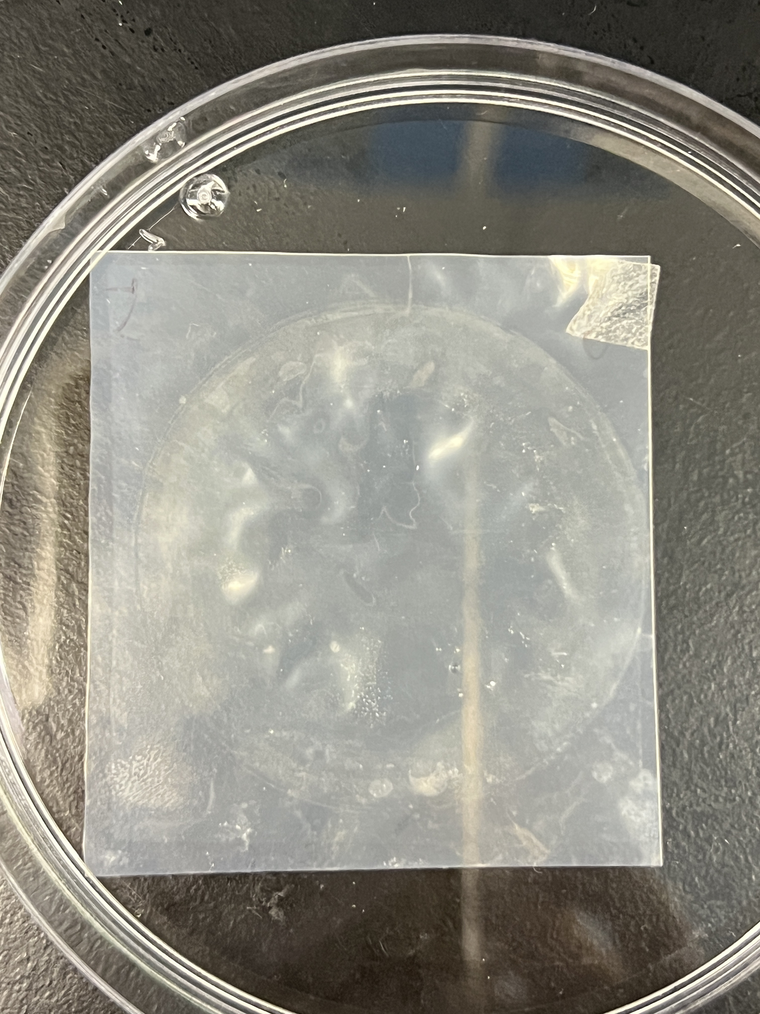
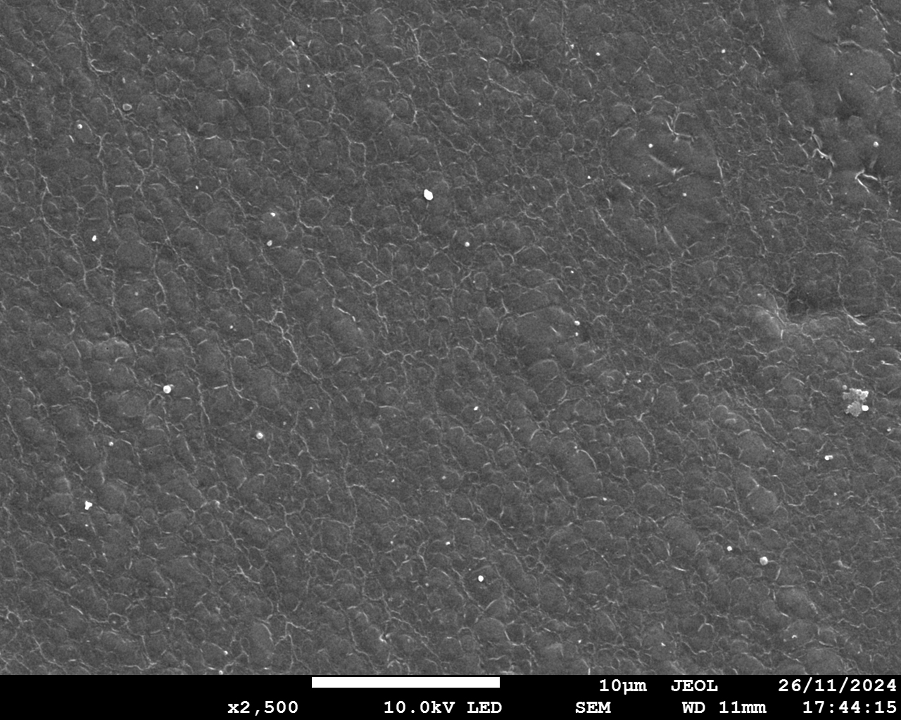
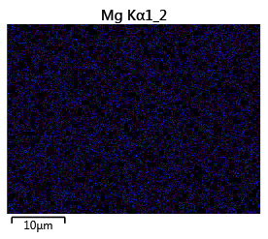
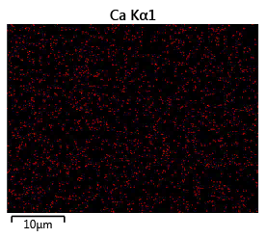
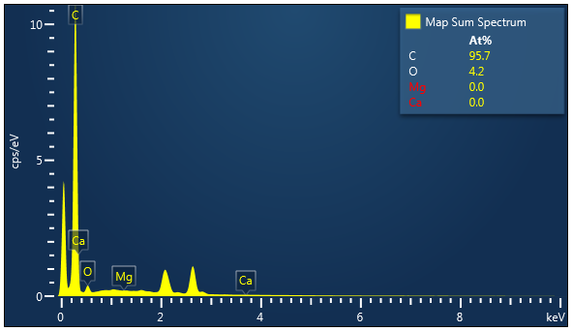
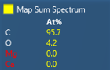
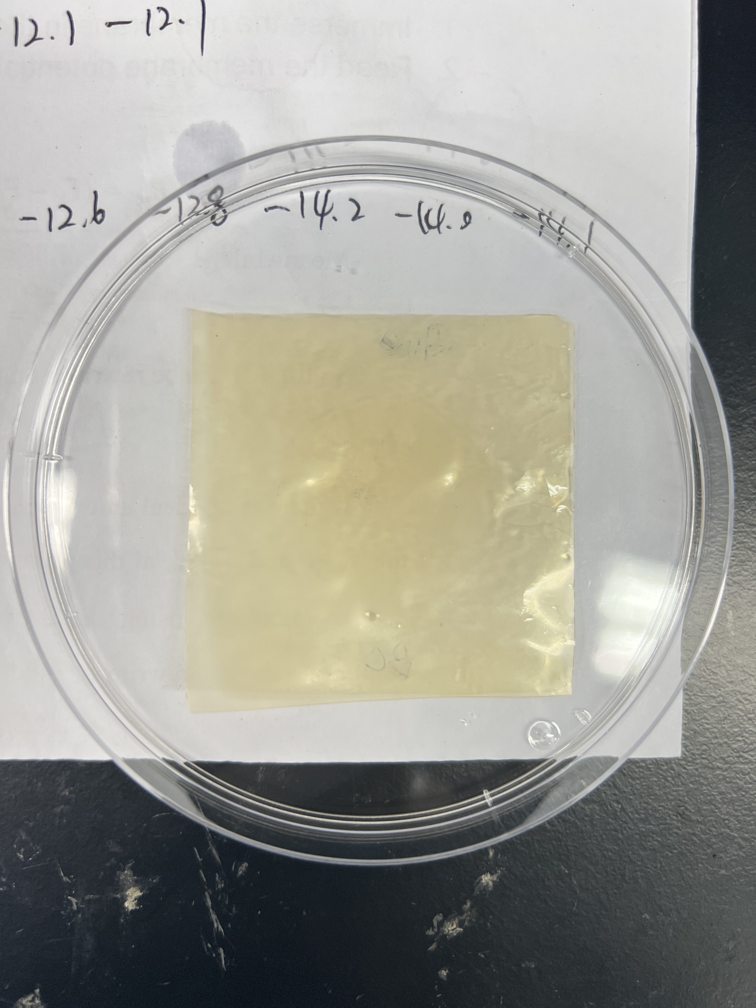
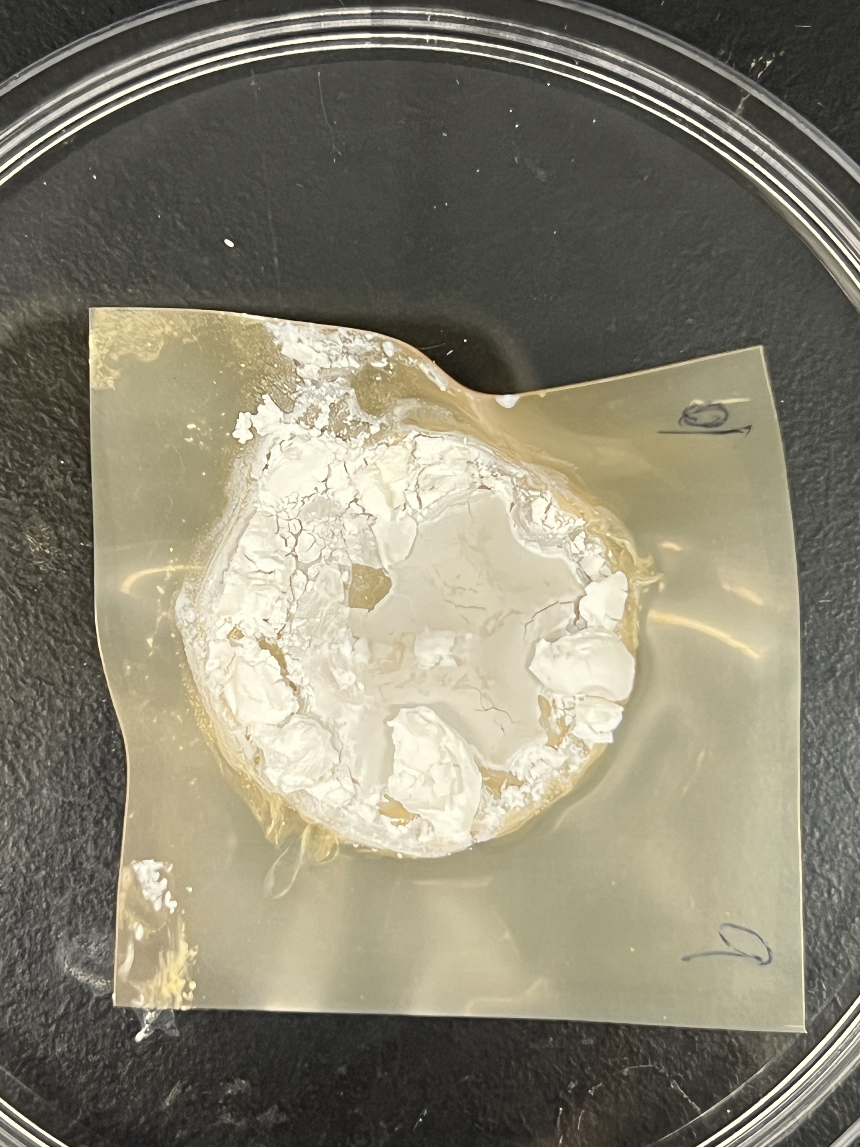
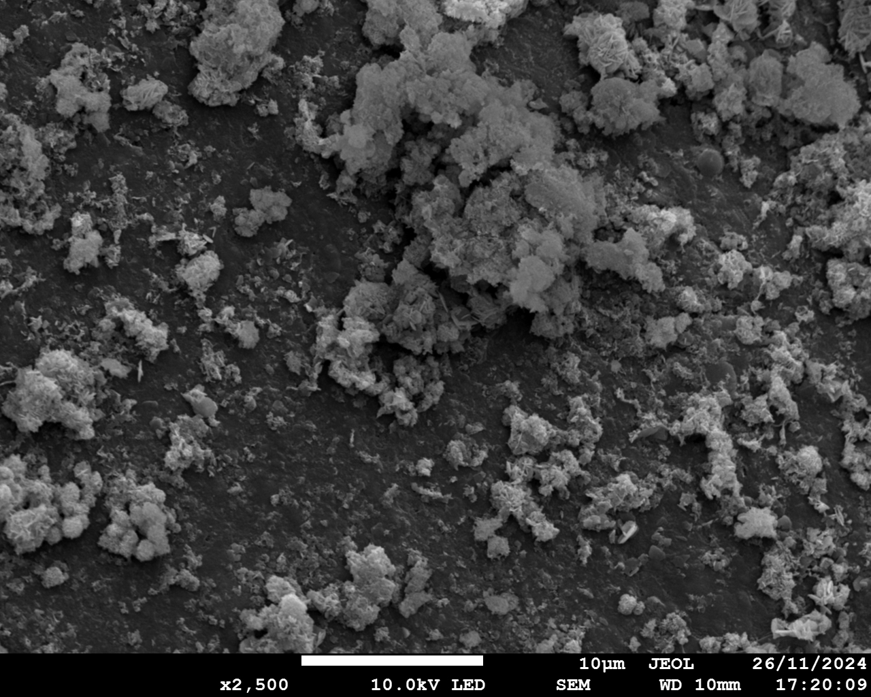
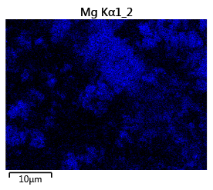
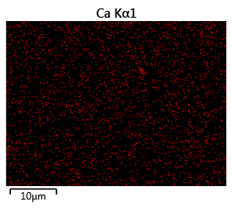
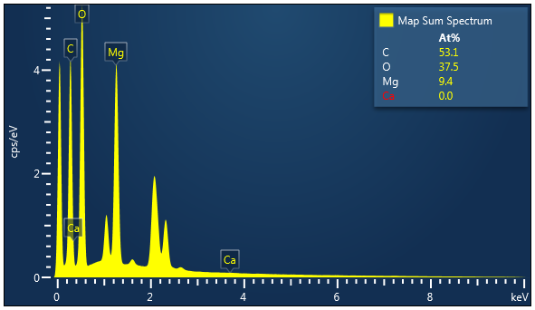
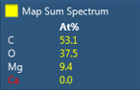
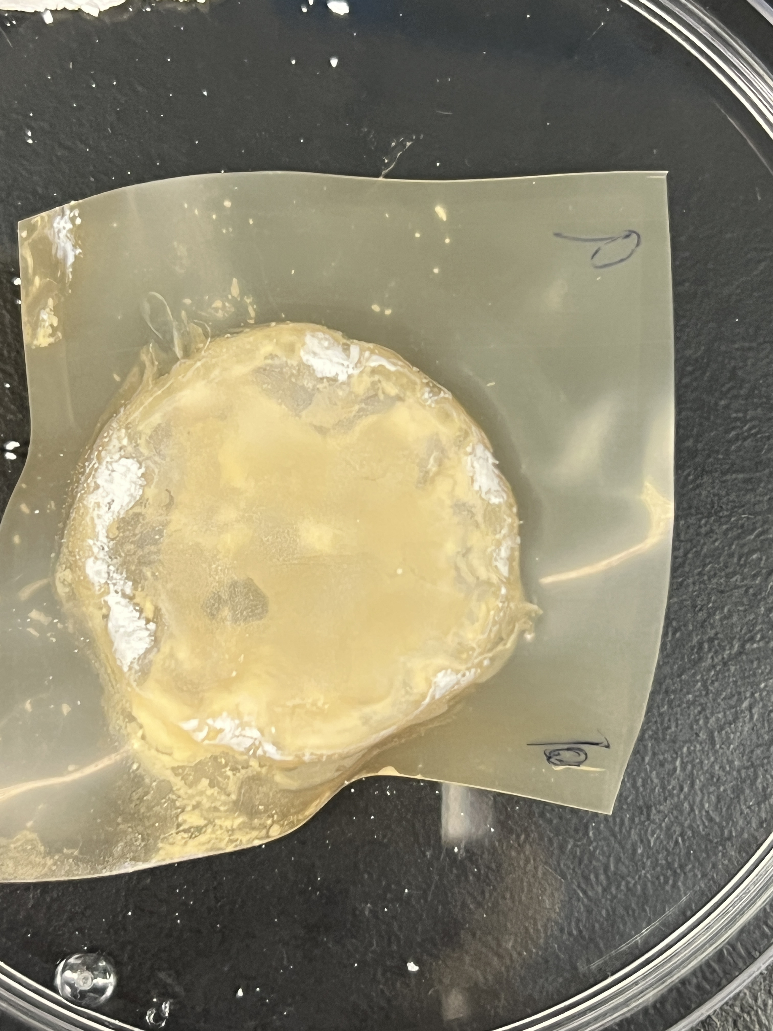
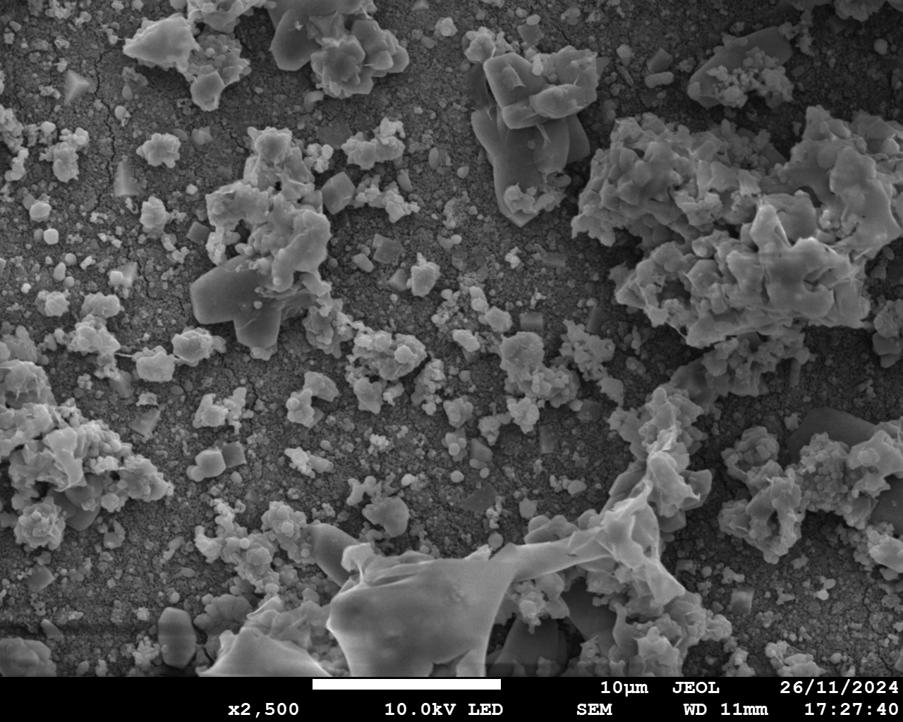
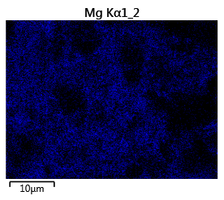
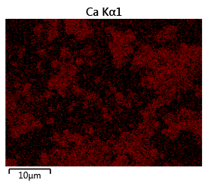
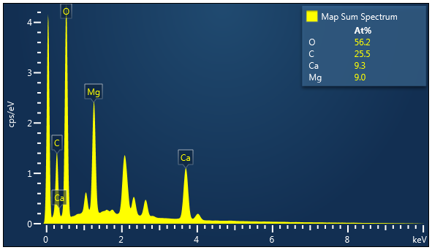
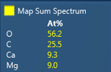
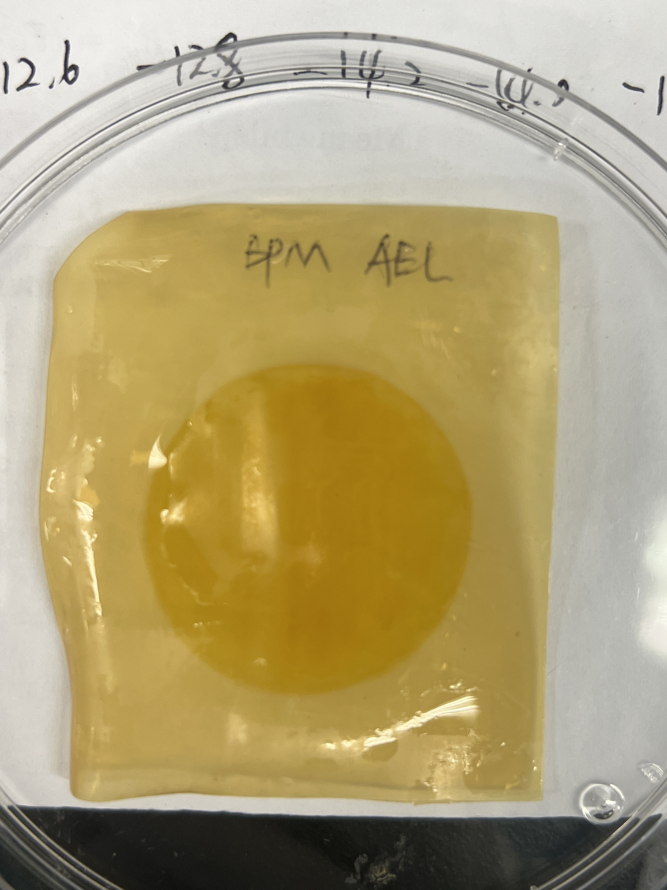
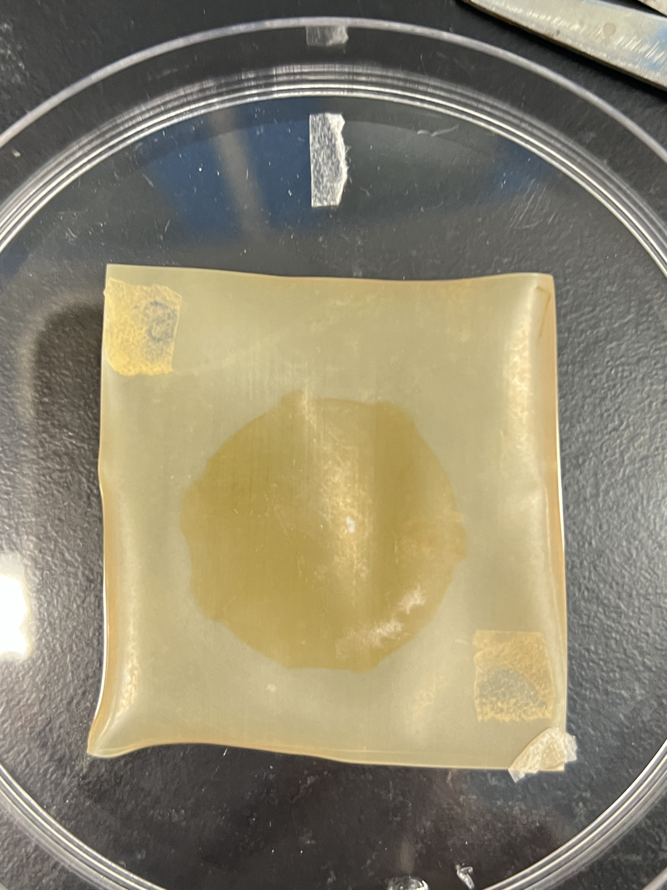
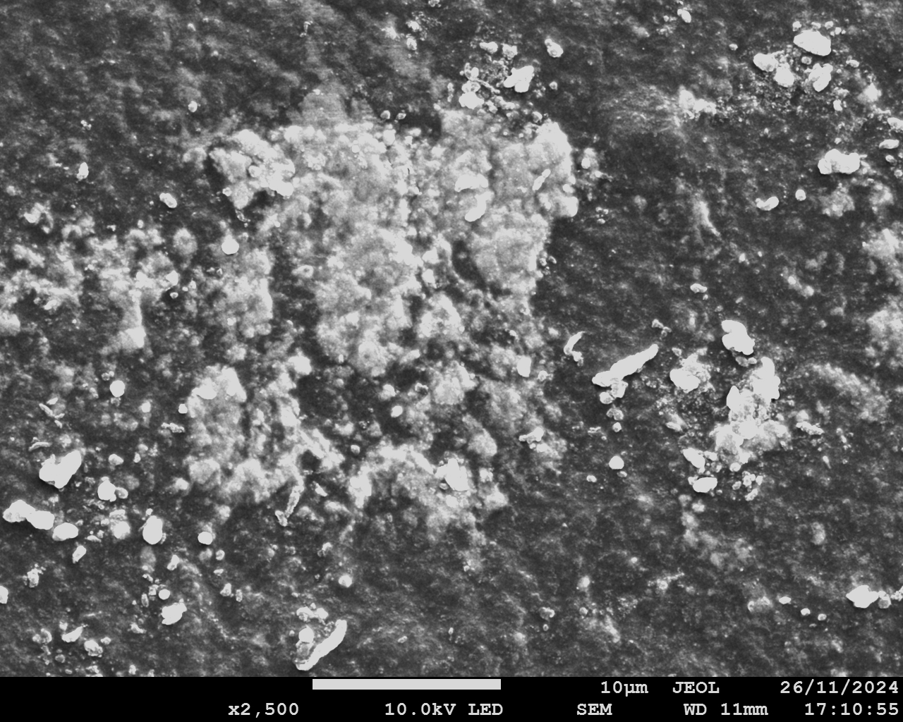
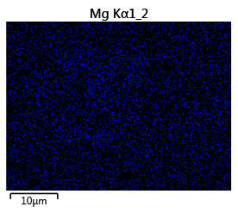
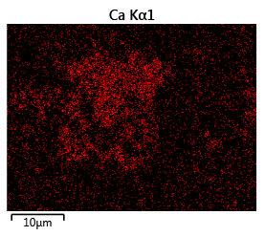
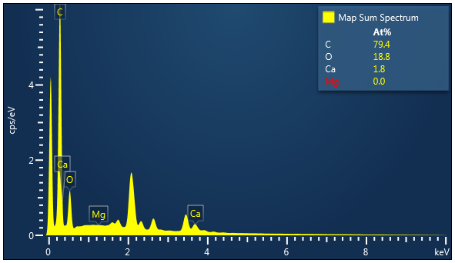
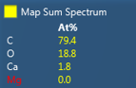
a1
NaCl
a2
SWB
a3
a4
Mg
a5
Ca
a6
AEM facing SWBC
1 cm
1 cm
10 μm
10 μm
10 μm
b1
NaCl
b2
SWB
b3
b4
Mg
b5
Ca
b6
CEM facing SWBC
1 cm
1 cm
10 μm
10 μm
10 μm
c1
NaCl
c2
SWB
c3
c4
c5
c6
Mg
Ca
CEM facing BC
1 cm
1 cm
10 μm
10 μm
10 μm
d1
NaCl
d2
SWB
d3
d4
Mg
d5
Ca
d6
BPM facing BC
1 cm
1 cm
10 μm
10 μm
10 μm
Notes:
Figure 3. Characterization of IEMs. AEM facing SWBC: Photograph after tests in (a1) NaCl and (a2) SWB; (a3) SEM diagram; EDS elemental mapping image of (a4) Mg and (a5) Ca; (a6) EDS map spectrum. CEM facing SWBC: Photograph after tests in (b1) NaCl and (b2) SWB; (b3) SEM diagram; EDS elemental mapping image of (b4) Mg and (b5) Ca; (b6) EDS map spectrum. CEM facing BC: Photograph after tests in (c1) NaCl and (c2) SWB; (c3) SEM diagram; EDS elemental mapping image of (c4) Mg and (c5) Ca; (c6) EDS map spectrum. BPM facing BC: Photograph after tests in (d1) NaCl and (d2) SWB; (d3) SEM diagram; EDS elemental mapping image of (d4) Mg and (d5) Ca; (d6) EDS map spectrum. (AC: acid chamber; SWBC: seawater brine chamber; BC: base chamber).

Slide 5
a
b
Notes:
Figure 4. Quantification of scaling in BMED system. (a) The amount of scaling and (b) Reduction ratio of Mg²⁺ and Ca²⁺

Slide 6
a
b
Notes:
Figure 5. Concentration of Ca²⁺ and Mg²⁺ in (a) SWBC and (b) BC; (c) The transport number of counter-ions of pristine CEM, scaled CEM, CEM-Ca and CEM-Mg

Slide 7
CEM
CEM
CEM
SWBC
BC
SWBC
BC
SWBC
BC
OH⁻
OH⁻
OH⁻
OH⁻
OH⁻
Mg²⁺
Ca²⁺
Mg²⁺
Ca²⁺
Mg²⁺
Ca²⁺
OH⁻ + H⁺
Mg²⁺
Ca²⁺
OH⁻ + H⁺
H₂O
H₂O
Mg(OH)₂ ↓
Ca(OH)₂ ↓
CaCO₃ ↓
H₂O
Mg(OH)₂ ↓
Ca(OH)₂ ↓
CaCO₃ ↓
OH⁻ + H⁺
Divalent ion transport
Scaling on CEM facing BC and in bulk solution
Water splitting on CEM facing BC
OH⁻ accumulated in SWBC
Scaling on CEM facing SWBC and in bulk solution
Water splitting on CEM facing SWBC
Scaling in SWBC was enhanced
Notes:
Figure 6. Schematic diagram of scaling formation mechanisms on CEM.

Slide 8
CEM
BPM
SWBC
BC
+
EC
-
OH⁻
+
Mg²⁺
Mg²⁺
-
+
OH⁻
-
H⁺
Ca²⁺
Ca²⁺
Ca²⁺
+
-
+
Ca(OH)₂ ↓
-
Notes:
Figure 7. (a) schematic diagram of scaling formation on BPM.

Slide 9
SI

Slide 10
Section S1. The composition of model seawater brine
Notes:
Table S1. The composition of model SWB

Slide 11
Section S2. System electrical resistance calculation
BPM
O₂
-
H₂
H⁺
+
OH⁻
+
-
-
OH⁻
H⁺
+
-
Electrode Chamber
Na₂SO₄
Notes:
Figure S1. Schematic experimental setup for determining the electrode resistance. (Conditions: electrode solution = 0.3 M Na₂SO₄, current density = 5~20 mA/cm²)

Slide 12
Section S2. System electrical resistance calculation
Notes:
Figure S2 The change of voltage drop of the electrode compartment as a function of direct current. (The read line is the fitting curve)

Slide 13
Section S4: BMED acid/base conductivity, acid/base production rate, and SEC
Notes:
Figure S3 The conductivity change of acid chamber and base chamber. (AC: acid chamber; BC: base chamber)

Slide 14
Section S4: BMED acid/base conductivity, acid/base production rate, and SEC
a
b
Notes:
Figure S4. The acid and base production rate change with time

Slide 15
Section S4: BMED acid/base conductivity, acid/base production rate, and SEC
Notes:
Figure S4. The energy consumption of the entire process to produce acid and base.

Slide 16
a
b
c
d
Notes:
Figure S5. Performance change before scaling, after scaling and after cleaning.

Slide 17
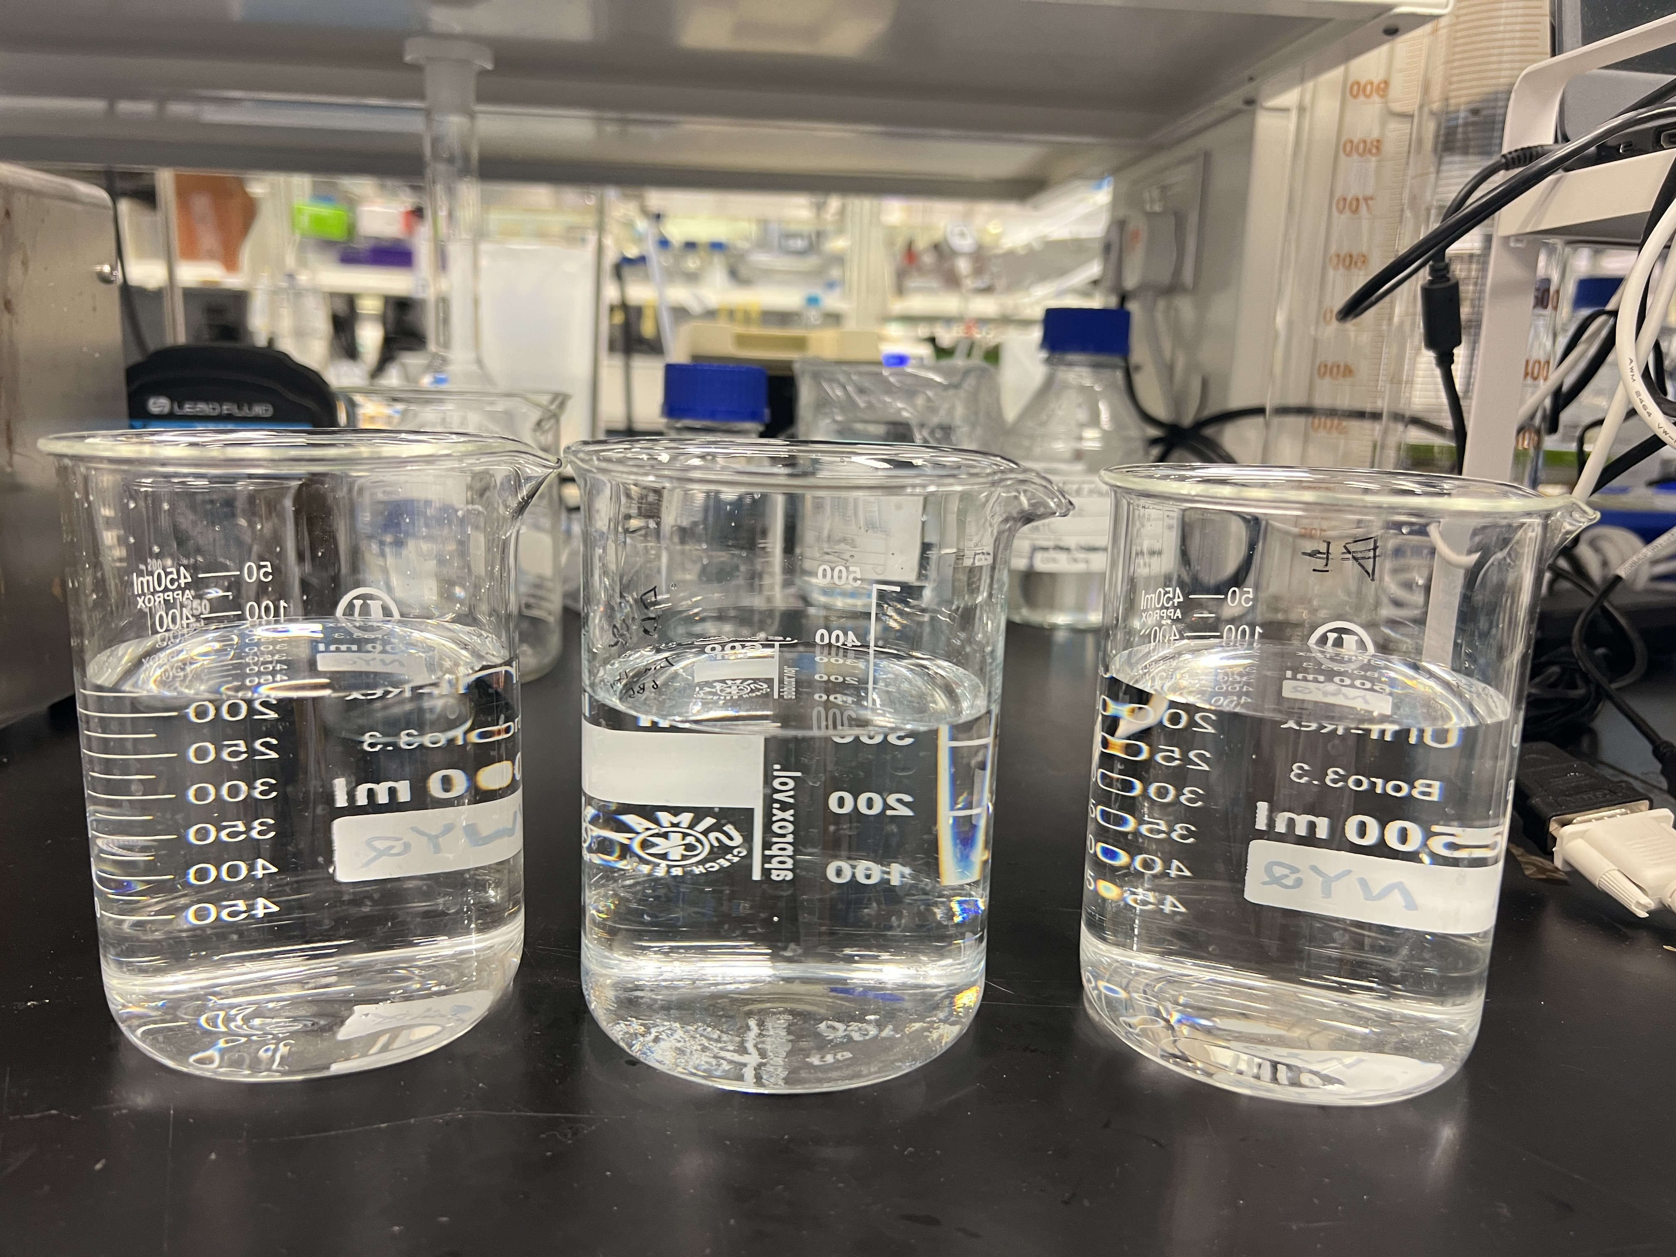
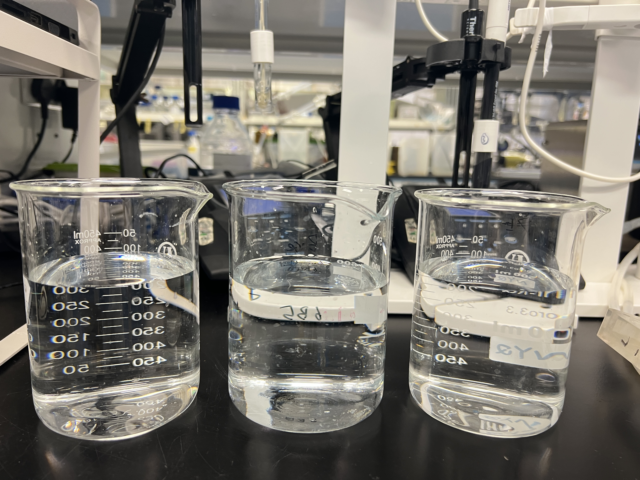
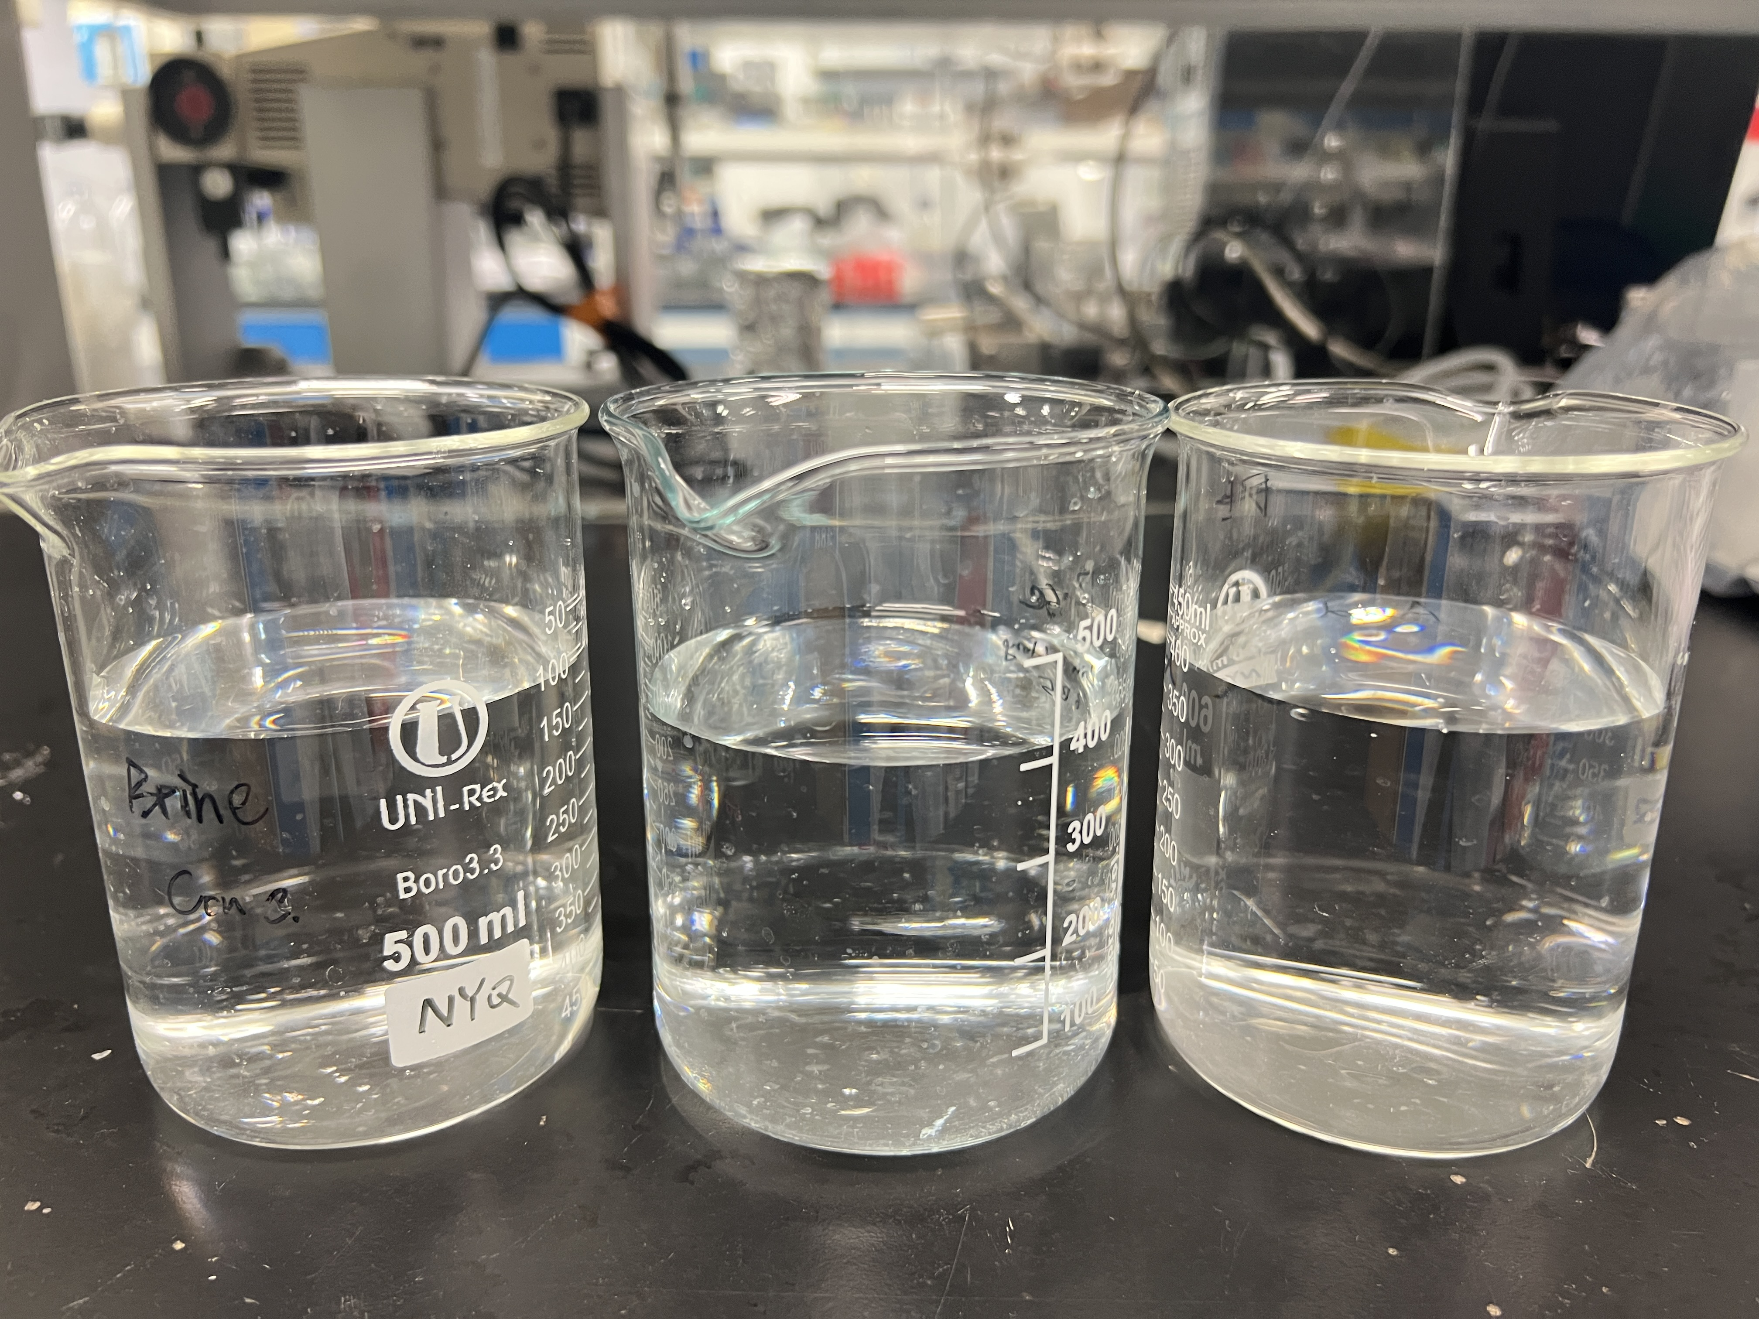
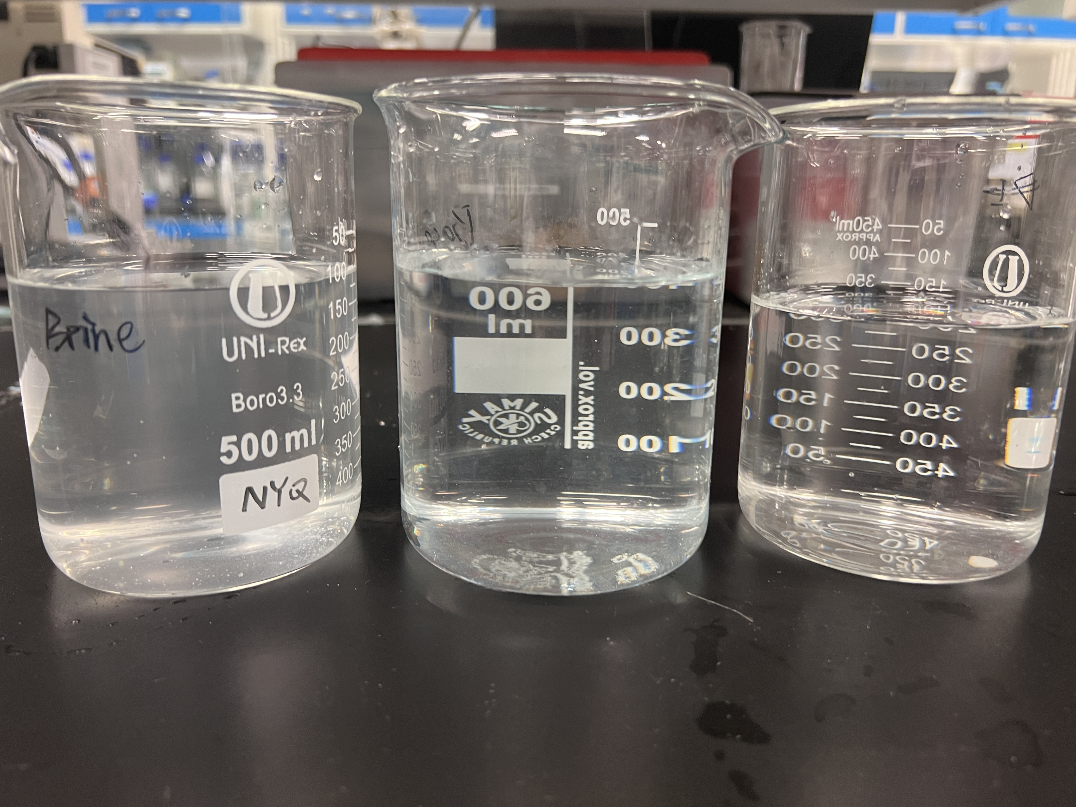
Section S5. Scaling formation in chambers
(a1) Solutions at the beginning of testing (NaCl)
(a2) Solutions at the end of testing (NaCl)
Brine
Base
Acid
Brine
Base
Acid
(b1) Solutions at the beginning of testing (SWB)
(b2) Solutions at the end of testing (SWB)
Brine
Base
Acid
Brine
Base
Acid
Notes:
Figure S6. Photos of solution at the beginning of testing and at the end of testing (NaCl & SWB).

Slide 18
Section S5. Scaling formation in chambers
Notes:
Table S2. Turbidity of solutions at the beginning and end of testing.

Slide 19
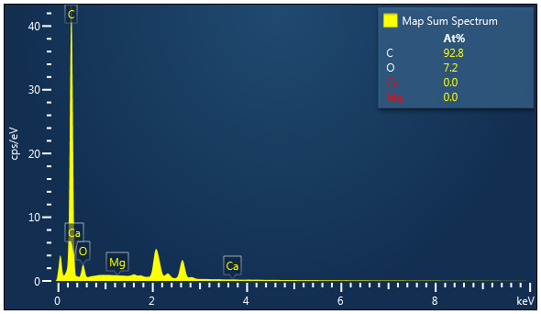
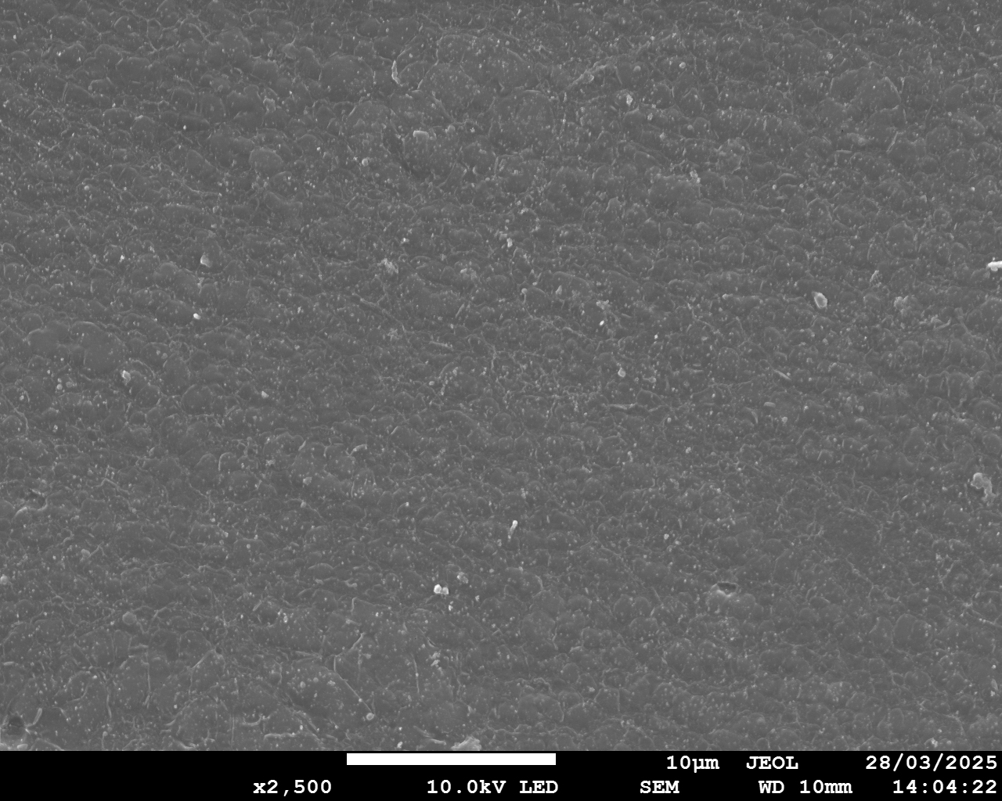
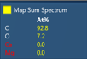
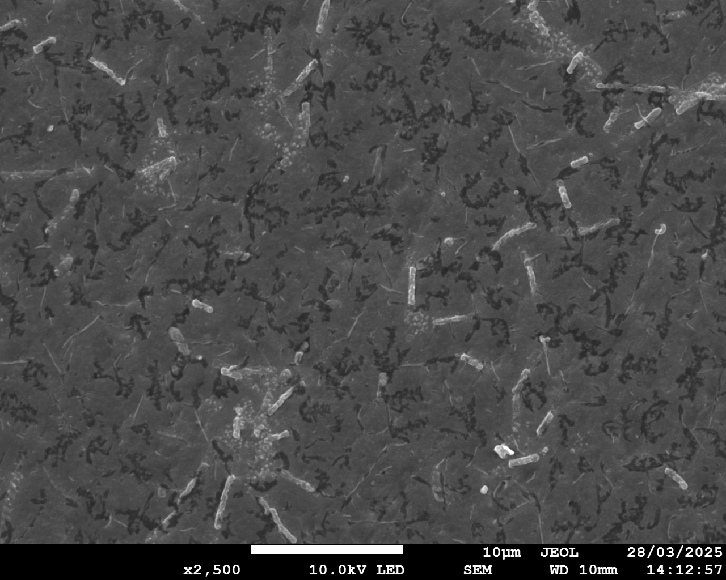
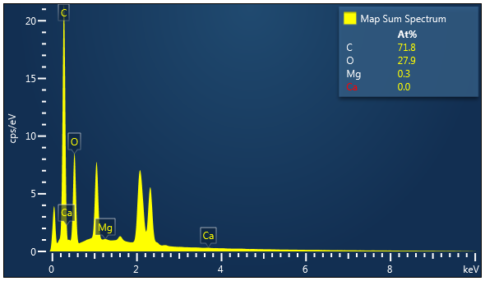
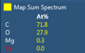
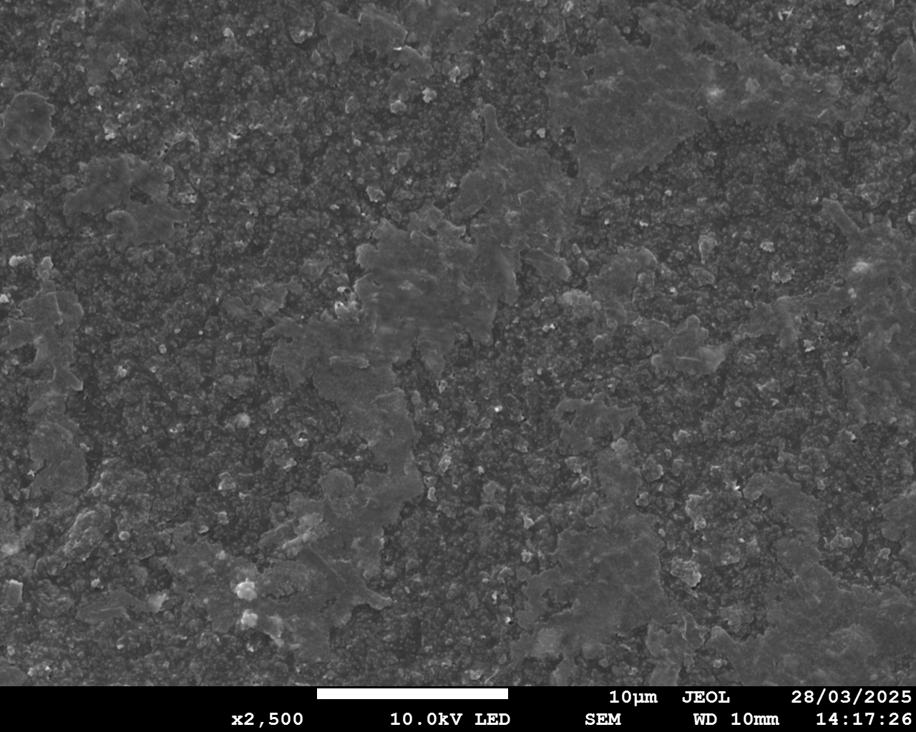
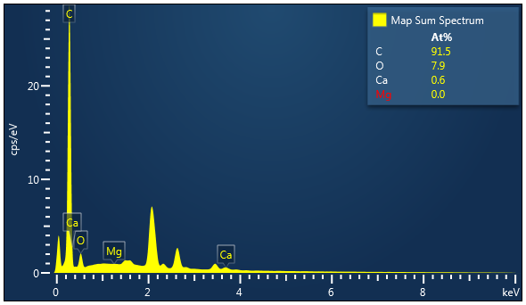
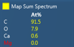
Section S6. Characterization of pristine membranes and membranes after NaCl tests
a1
a2
10 μm
b1
b2
10 μm
c1
c2
10 μm
Notes:
Figure S7. Characterization of pristine IEMs. AEM: (a1) SEM image; (a2) EDS map spectrum. CEM: (b1) SEM image; (b2) EDS map spectrum. BPM (AEL): (c1) SEM image; (c2) EDS map spectrum

Slide 20
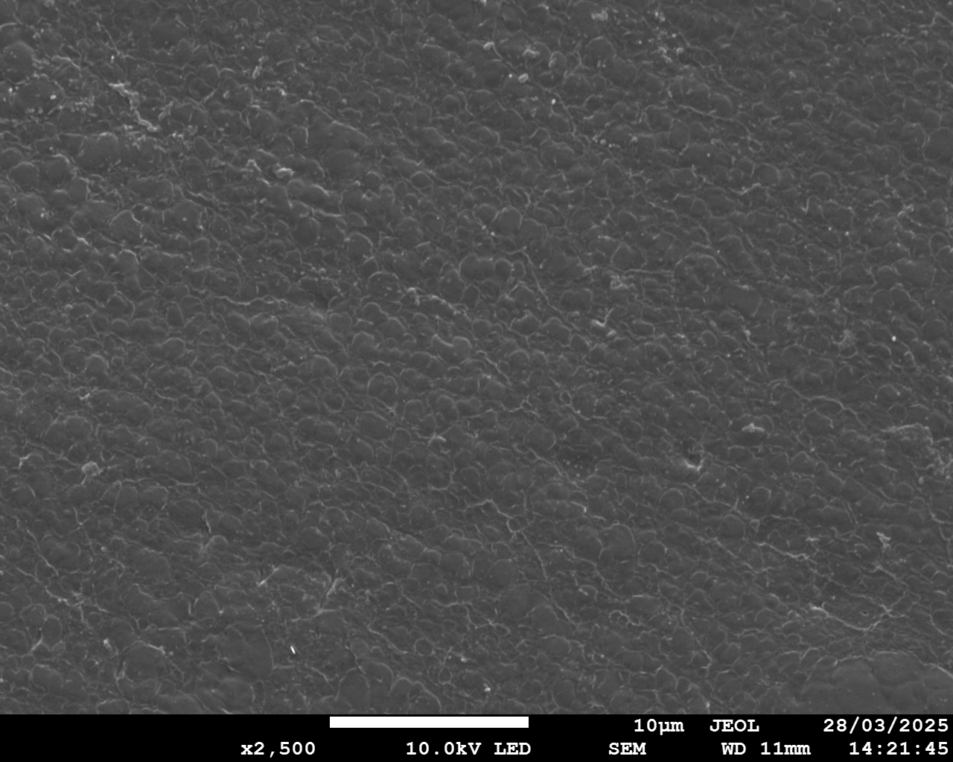
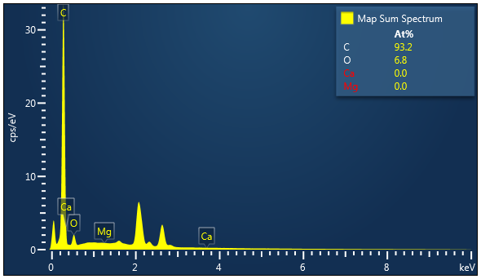
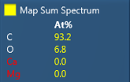
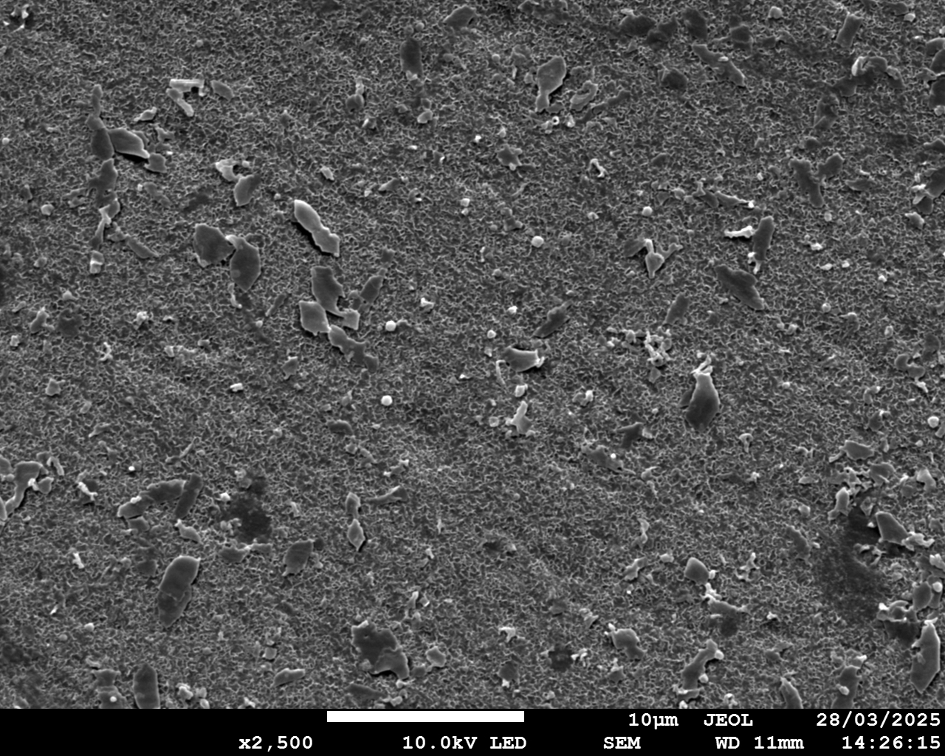

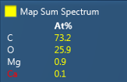
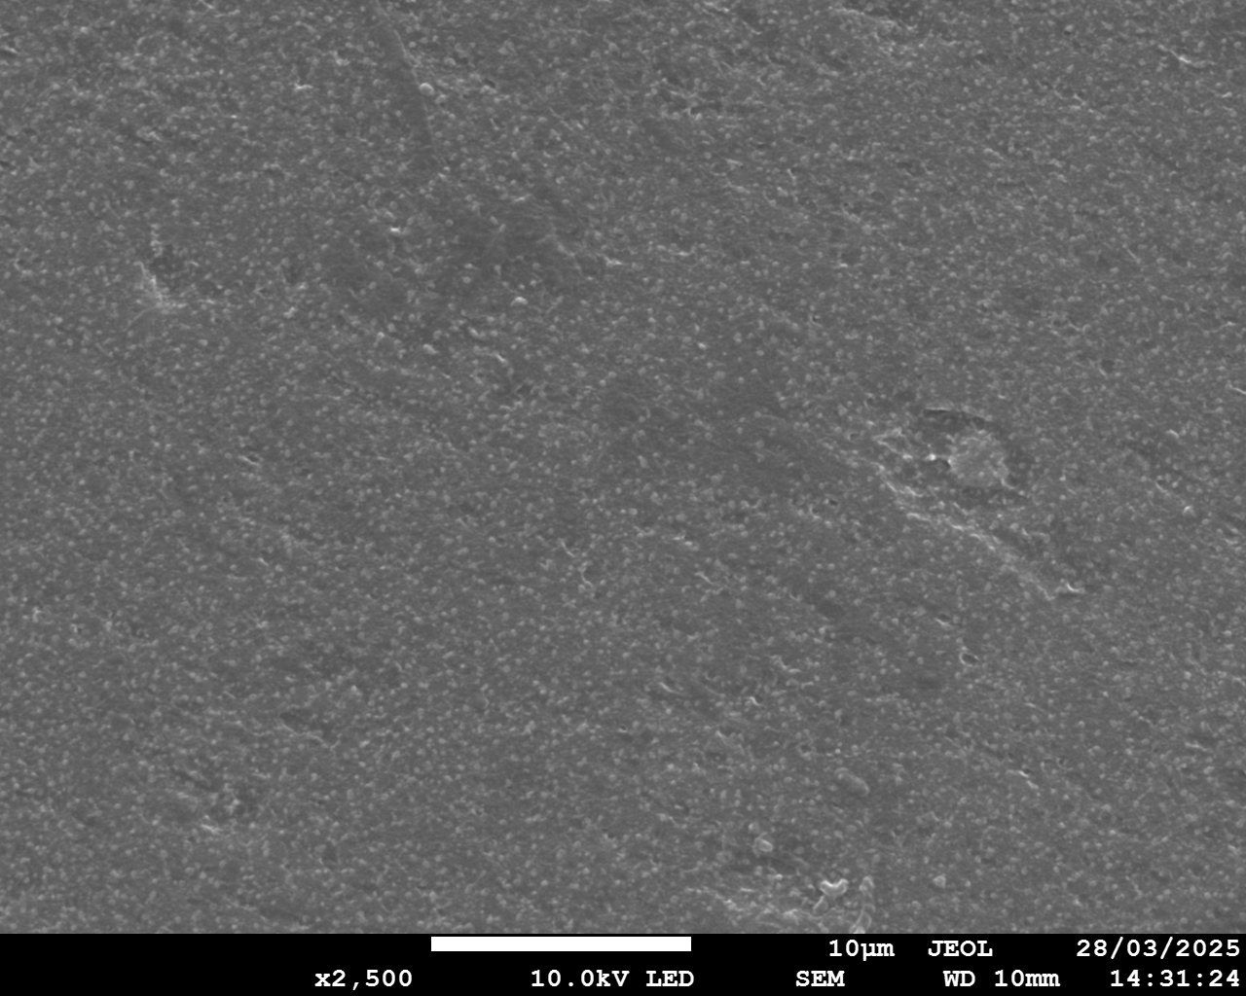
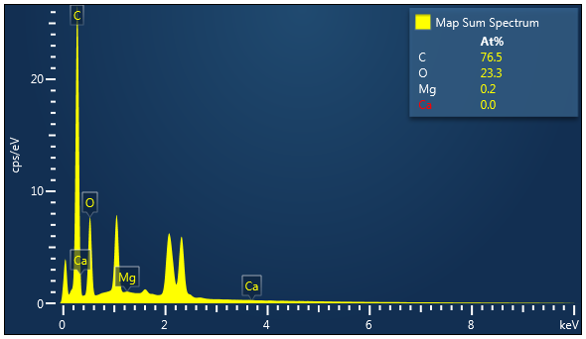
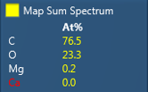
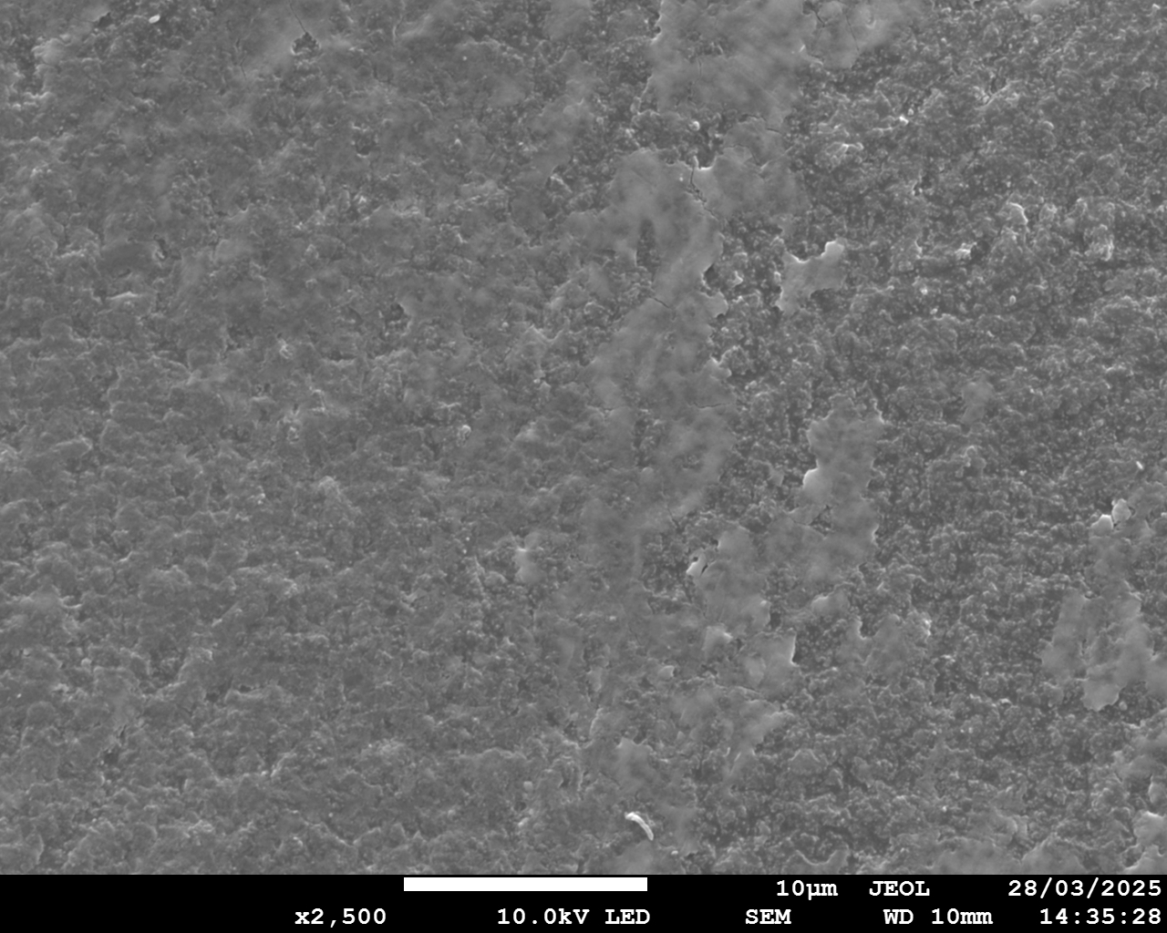
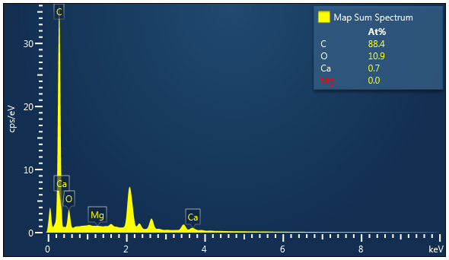

Section S6. Characterization of pristine membranes and membranes after NaCl tests
a1
a2
10 μm
b1
b2
10 μm
c1
c2
10 μm
d1
d2
10 μm
Notes:
Figure S8. Characterization of IEMs after BMED tests treating NaCl. AEM facing SWBC: (a1) SEM image; (a2) EDS map spectrum. CEM facing SWBC: (b1) SEM image; (b2) EDS map spectrum. CEM facing BC: (c1) SEM image; (c2) EDS map spectrum. BPM facing BC: (d1) SEM image; (d2) EDS map spectrum

Slide 21




Section S7. The composition of scaling
Scaling on CEM facing SWBC
a
b
100 μm
c
Mg
d
Ca
100 μm
100 μm
Notes:
Figure S9. The morphology of deposits on CEM facing SWBC (a) SEM image; (b) EDS map spectrum; EDS elemental mapping image of (c) Mg and (d) Ca;

Slide 22









Section S7. The composition of scaling
Scaling on CEM facing BC
a1
CaCO_{3.}
a2
a3
Mg
a4
Ca
1 μm
1 μm
1 μm
Mg(OH)₂
b1
b2
b3
b4
Ca
Ca
Mg
Mg(OH)₂
1 μm
1 μm
1 μm
Notes:
Figure S10. The morphology of deposits on CEM facing BC: (a1)(b1) SEM images; (a2)(b2) EDS map spectrum; EDS elemental mapping image of (a3)(b3) Mg and (a4)(b4) Ca.

Slide 23
Section S7. The composition of scaling
Brucite Mg(OH)₂
Calcite CaCO₃
Portlandite Ca(OH)₂
NaCl
Notes:
Figure S11. X-ray diffraction spectra for the precipitates collected in the stack.

Slide 24
Section S7. The method to quantify scaling
Notes:
Figure S12. The concentration change of Mg²⁺ and Ca²⁺ in the acid chamber.

Slide 25
Section S8. The calculation of transport number
V
Multimeter
0.2M NaOH
0.1M NaOH
Notes:
Figure S13. The stack diagram

Slide 26
Notes:
S14

Slide 27








a1
a2
a3
a4
Mg
Ca
Surface
Cross-section
1 μm
1 μm
1 μm
b1
b2
b3
b4
Mg
Ca
Surface
Cross-section
1 μm
1 μm
1 μm
Notes:
Figure S15 The SEM graph and EDS map spectrum of cross-section of membranes (White line is the dividing line of cross-section and membrane surface). Cross-section of CEM after tests: (a1) SEM diagram; (a2) EDS map spectrum; (a3) EDS elemental mapping image of Ca; (a4) EDS elemental mapping image of Mg. Cross-section of BPM(AEL) after tests: (b1) SEM diagram; (b2) EDS map spectrum; (b3) EDS elemental mapping image of Ca; (b4) EDS elemental mapping image of Mg.

